Slide 1
Presentation brief for MCT’s
Title of presentation | Running Experiments and Training Models
Presentation length | 120 minutes (including labs)
Audience | Data Scientists planning to operate machine learning workloads on Azure
Purpose | Introduce experiments and how to run them Describe how to use experiments to train models
(think) Student key takeaways | Experiments encapsulate tasks that are run, and usually generate metricss and outputs Estimators are used to simplify configuration for experiments that train models
(feel) Student desired mindset | Familiar with terminology like “experiment”, “run”, “metrics”, “outputs”. Comfortable configuring and running an experiment to train a model
(do) Student outcomes | Run Python code as an experiment that logs metrics and generates outputs Use an estimator to run a model training experiment, and register the resulting model
More information | For course feedback, please use the MCT Forums

Slide 2

Module 3: Running Experiments and Training Models

Slide 3
Agenda
Introduction to Experiments
Training and Registering Models

Slide 4


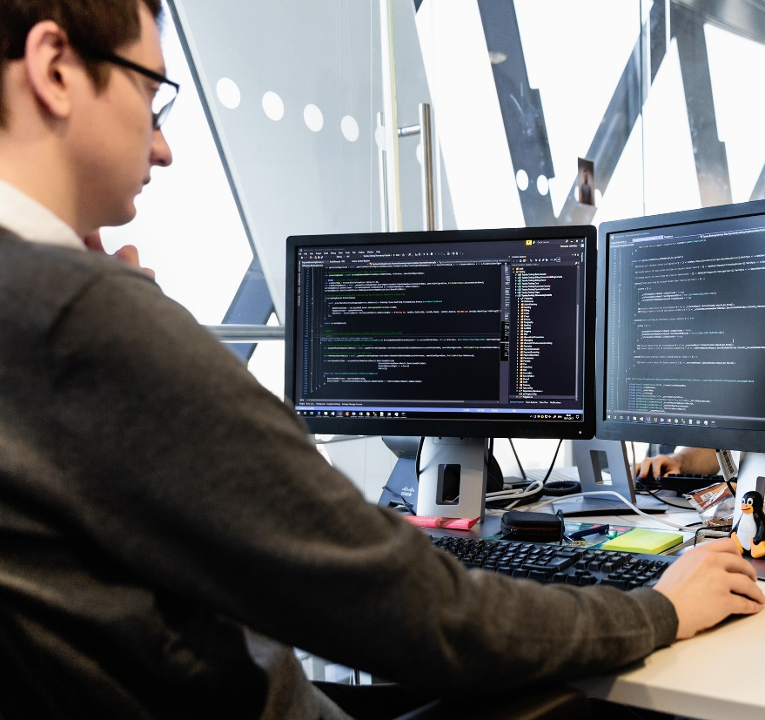
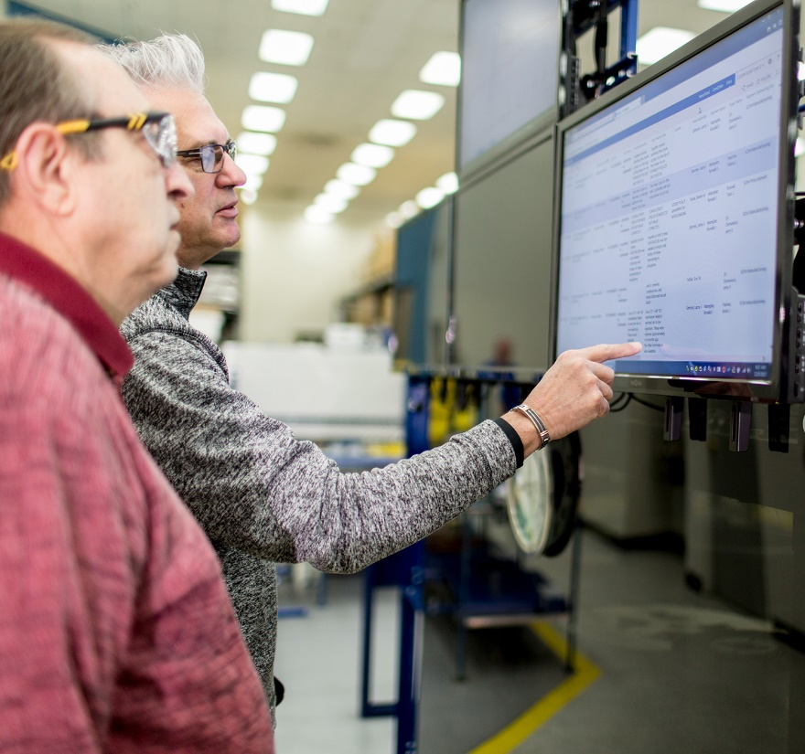






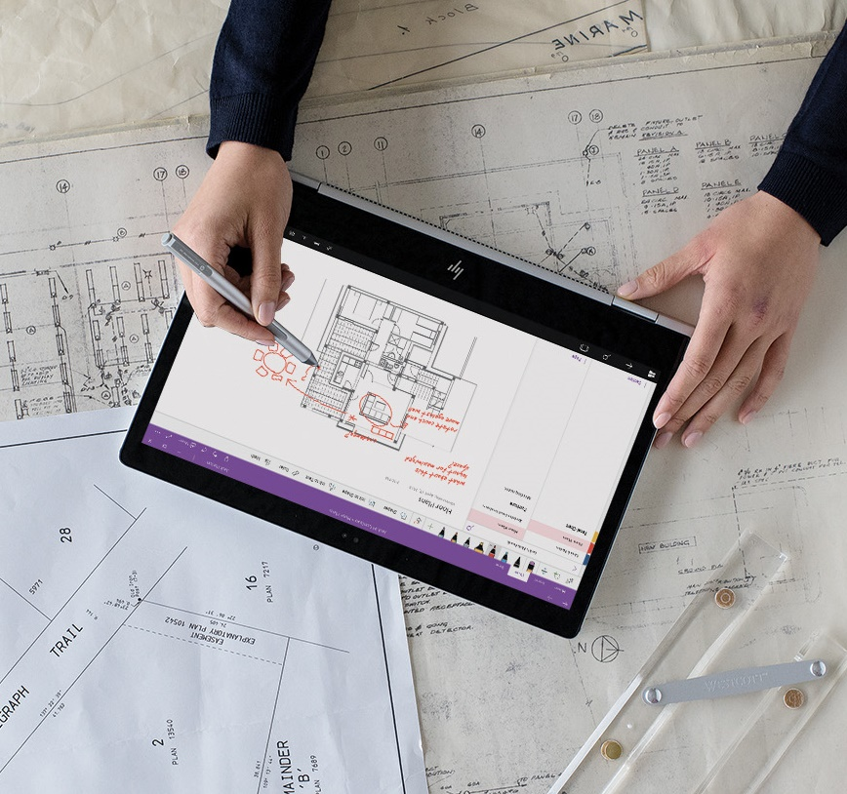


Lesson 1
Introduction to Experiments
Data
Cloud
AI

Slide 5







What is an Experiment?
An executable process that is run one or more times – often a script
Each run generates metrics and output files

Slide 6
Logging Metrics and Creating Outputs
Log metrics using the run context from the Run object:
log: Record a single named value
log_list: Record a named list of values
log_row: Record a row with multiple columns
log_table: Record a dictionary as a table
log_image: Record an image file or a plot
Save output files in the outputs folder for the run
from azureml.core import Experiment
import pandas as pd
experiment = Experiment(workspace = ws, name = 'my-experiment')
run = experiment.start_logging()
data = pd.read_csv('data.csv')
row_count = (len(data))
run.log('observations', row_count)
data.sample(100).to_csv('sample.csv', index=False, header=True)
run.upload_file(name = 'outputs/sample.csv', path_or_stream = './sample.csv')
run.complete()

Slide 7
Running a Script as an Experiment
Get the run context in the experiment script:
Define the run configuration and script run configuration
from azureml.core import Run
run = Run.get_context()
run.log(…)
run.complete()
from azureml.core import Environment, Experiment, RunConfiguration, ScriptRunConfig
run_config = RunConfiguration()
run_env = Environment('experiment-env')
src = ScriptRunConfig(source_directory='experiment_files',
script='experiment.py',
run_config=run_config)
experiment = Experiment(workspace = ws, name = experiment_name)
run = experiment.submit(config=src)

Slide 8
Lab 3A
Running Experiments
https://aka.ms/msl-dp100

Slide 9
Lesson Review
Complete the Review Questions

Slide 10
Lesson 2
Training and Registering Models
Data
Cloud
AI

Slide 11
Introduction to Estimators
An abstraction over run and script configurations
Encapsulate environments for common frameworks:
Scikit-Learn
PyTorch
Tensorflow
Chainer
from azureml.train.estimator import Estimator
from azureml.core import Experiment
estimator = Estimator(source_directory='experiment_folder',
entry_script='training_script.py'
compute_target='local',
conda_packages=['scikit-learn'])
experiment = Experiment(workspace = ws, name = 'training_experiment')
run = experiment.submit(config=estimator)

Slide 12
Using Script Parameters
Parse arguments in the script
Include script parameters in the estimator
import argparse
parser = argparse.ArgumentParser()
parser.add_argument('--reg_rate', type=float, dest='reg', default=0.01)
args = parser.parse_args()
reg = args.reg
estimator = Estimator(source_directory='experiment_folder',
entry_script='training_script.py'
compute_target='local',
script_params = {'--reg_rate': 0.1},
conda_packages=['scikit-learn'])

Slide 13
Registering a Model
Model registration enables version tracking and retrieval
run.register_model( model_name='classification_model',
model_path='outputs/model.pkl',
description='A classification model',
tags={'dept': 'sales'},
model_framework=Model.Framework.SCIKITLEARN,
model_framework_version='0.19.1'))
from azureml.core import Model
for model in Model.list(ws):
print(model.name, 'version:', model.version)

Slide 14
Lab 3B
Training and Registering Models
https://aka.ms/msl-dp100

Slide 15
Lesson Review
Complete the Review Questions

